Slide 1
0ALD515 · RESEARCH IN COMPUTER SCIENCE B
An Empirical Analysis of Entangled Enhancement
in an Autonomous Driving Pipeline
PRESENTER
SUPERVISOR
Ifty Rashedul Arefin
Fumio Machida
Student ID: 202620721
Associate Professor
理工情報生命学術院
システム情報工学研究群
情報理工学位プログラム
Department of Systems and Information Engineering
University of Tsukuba
Dependable AI Systems Laboratory
University of Tsukuba
22 October 2026

Slide 2
Outline
I
Background and Existing Studies
Entangled enhancement and the limitation of existing studies
II
Objective and Research Questions
What this study investigates, and why
III
Target Pipeline and Experimental Setup
Data, pipeline, updates of C₁, and one experiment for each research question
IV
Results
One answer for each research question
V
Conclusion and Future Work
Summary and the next step toward early detection
An Empirical Analysis of Entangled Enhancement in an Autonomous Driving Pipeline
2

Slide 3
Background: Entangled Enhancement
I · BACKGROUND
MACHINE LEARNING SYSTEM (MLS) AS A PIPELINE
Each model uses the output of the upstream model before it. The models after it are downstream.
DEFINITION
Entangled enhancement is a defective retraining of an ML model that improves the updated model but fails to improve the whole system.
image
C₁
C₂
C₃
path
Perception model
Prediction model
Planning model
retraining
C₁′
The performance of C₁′ improves.
Updated model
The performance of the MLS does not improve.
Wang and Machida, COMPSAC 2024 and ISSRE 2025
Possible cause studied here: adaptation of downstream models
A downstream model is trained on the output of the original upstream model, including its errors. The downstream model learns to work with these errors. The retraining changes these errors.
An Empirical Analysis of Entangled Enhancement in an Autonomous Driving Pipeline
3

Slide 4
Motivation
I · BACKGROUND
THE CHALLENGE
1
Updates are routine.
A driving system retrains its perception model C₁ when it meets new data, for example a new city.
2
Downstream models adapt to C₁.
C₂ and C₃ are trained on the output of C₁ and learn to work with the errors of C₁.
3
A better C₁ is not always a better pipeline.
Entangled enhancement can increase the error of C₂ and C₃.
4
Little is known about real pipelines.
Existing studies describe the risk but do not examine entangled enhancement in a real autonomous driving pipeline.
PRIMARY
GOAL
Find out whether an update that improves C₁ increases the error of C₂ and C₃ in a real autonomous driving pipeline, and whether the adaptation of C₂ and C₃ to the errors of C₁ causes the increase.
An Empirical Analysis of Entangled Enhancement in an Autonomous Driving Pipeline
4

Slide 5
Existing Studies and Their Limitation
I · BACKGROUND
STUDY | WHAT THE STUDY SHOWS | WHAT REMAINS OPEN
Sculley et al. NIPS 2015 | A change to one model of an MLS changes the behaviour of every model that uses its output. | The study describes the risk. The study does not measure how often the risk occurs.
Wu et al. NeurIPS 2021 | Improving one model of a system can make the whole system worse. | The study does not examine a pipeline of perception, prediction and planning models.
Wang and Machida COMPSAC 2024, ISSRE 2025 | Models of when an MLS should retrain each of its ML models. | The models take the probability of entangled enhancement as an input.
Xu et al. ICRA 2024 | The prediction error increases when the input comes from a real perception model instead of the ground truth, which consists of the objects labelled by hand. | The study does not examine a retraining of the perception model.
RESEARCH
GAP
None of these studies examined the significance of entangled enhancement in a real autonomous driving pipeline of perception, prediction and planning models.
An Empirical Analysis of Entangled Enhancement in an Autonomous Driving Pipeline
5

Slide 6
Objective and Research Questions
II · OBJECTIVE
OBJECTIVE
In this study, we empirically investigate whether an update that improves the perception model C₁ increases the error of the prediction model C₂ and the planning model C₃. When increased errors are observed, we further investigate the impact of adaptation of C₂ and C₃.
RQ1 · OCCURRENCE
RQ2 · CAUSE
Does an update that improves C₁ increase the error of C₂ or C₃?
Does the increase come from the adaptation of C₂ and C₃ to the errors of C₁?
WHY WE ASK
WHY WE ASK
Existing studies describe the risk of entangled enhancement. None of these studies examined the risk in a real autonomous driving pipeline.
Only training on the output of C₁ lets C₂ and C₃ learn the errors of C₁. An update then changes these errors.
Experiment: update C₁ 30 times. C₂ and C₃ are trained on the output of C₁ and stay fixed.
Experiment: compare C₂ and C₃ trained on the ground truth with C₂ and C₃ trained on the output of C₁, on the same 30 updates.
An Empirical Analysis of Entangled Enhancement in an Autonomous Driving Pipeline
6

Slide 7
Target Pipeline and Notation
III · SETUP
AUTONOMOUS DRIVING PIPELINE OF THREE ML MODELS
C₁ · Perception model
C₂ · Prediction model
C₃ · Planning model
Front-camera
image
YOLOv11n object detector
AutoBot-Ego style transformer
PlanT style transformer
Output: objects with class, position and confidence
Input: objects in the last four labelled images (1.5 s)
Output: six possible paths of 3 s for each object
Input: objects with their most likely path, driving command, path of the ego vehicle over the last 1.5 s (ego path)
Output: planned path of the ego vehicle for 3 s
NOTATION FOR ONE UPDATE OF C₁
δ₁
Δ₂
Δ₃
ENTANGLED ENHANCEMENT
An update causes entangled enhancement when
Gain of C₁ in mAP50, the standard accuracy measure of object detection
Increase of the prediction error minADE: distance between the predicted and the true path, for the best of the six paths
Increase of the planning error: distance between the planned and the recorded position at 3 s (path driven by a human driver)
δ₁ > 0 and
(Δ₂ > 0 or Δ₃ > 0)
An Empirical Analysis of Entangled Enhancement in an Autonomous Driving Pipeline
7

Slide 8
Experimental Setup
III · SETUP
DATA SET
UPDATES OF C₁
350 of the 850 scenes of nuScenes (driving clips of about 20 s), front camera only, 4.6 GB
30
updates
= 2 initial C₁ × 15 settings
BOSTON 1
100 scenes
BOSTON 2
100 scenes
Training of C₁
Training of C₂ and C₃
Initial C₁: YOLOv11n, 10 epochs on Boston 1. The 30 updates differ in data, epochs, seed and initial C₁.
Two initial C₁, with random seed 0 and seed 1
86 training and 14 validation scenes, separate from Boston 1
DATA USED | EPOCHS | SETTINGS
100 %, 50 %, 25 % | 10 | 3 × 3 seeds = 9
100 % | 5 or 20 | 2 × 3 seeds = 6
SINGAPORE 1
100 scenes
SINGAPORE 2
50 scenes
Updates of C₁
Test
A new city, as in an update after deployment
1,720 test samples, one per labelled image with 3 s of future
A random seed is the starting number for the random choices in training.
ENVIRONMENT
Kaggle (GPU T4 x2) · Intel Xeon 2.0 GHz, 4 virtual cores · 31 GB RAM · Ubuntu 24.04
Training on one NVIDIA Tesla T4 (15 GB) · Python 3.13 · PyTorch 2.11 (CUDA 12.8) · Ultralytics 8.4
An Empirical Analysis of Entangled Enhancement in an Autonomous Driving Pipeline
8

Slide 9
Experiment for RQ1: Evaluation Procedure
III · SETUP · RQ1
PROCEDURE FOR EACH UPDATE
THREE LEVELS OF EVIDENCE FOR AN INCREASE
1
Run the pipeline with the initial C₁ on the 50 test scenes.
LEVEL 1
Any increase
Δ₂ > 0 or Δ₃ > 0
2
Run the same fixed C₂ and C₃ with the updated C₁′ on the same scenes.
LEVEL 2
Larger than seed variation
Seed variation is the change in error when we replace one initial C₁ by the other initial C₁. The two differ only in the random seed and have almost the same accuracy.
Threshold: Δ₂ > 0.112 m, Δ₃ > 0.018 m
3
Compute δ₁, Δ₂ and Δ₃ as the differences between the two runs.
4
Repeat for all 30 updates. C₂ and C₃ stay trained on the output of C₁ (pipe training).
LEVEL 3
Statistically significant
We randomly resample the 50 test scenes 2,000 times. The middle 95 % of the resampled increases lies above zero.
A single positive Δ can come from chance. Each level of evidence removes one source of chance.
weaker → stronger evidence
An Empirical Analysis of Entangled Enhancement in an Autonomous Driving Pipeline
9

Slide 10
Experiment for RQ2: Two Training Modes
III · SETUP · RQ2
ISO TRAINING
Ground truth
objects labelled by hand
Train C₂ and C₃
then keep them fixed
TEST AFTER EACH UPDATE
C₂ and C₃ never see
the errors of C₁
Both versions of C₂ and C₃ receive the output of the same C₁′ on the same test scenes. Only the training differs.
We also retrain C₂ and C₃ on the output of C₁′.
PIPE TRAINING
Output of C₁
including its errors
Train C₂ and C₃
then keep them fixed
C₂ and C₃ learn
the errors of C₁
HOW WE READ THE COMPARISON
The error increases only after pipe training.
→
The increase comes from the adaptation of C₂ and C₃ to the errors of C₁.
The error increases after both training modes.
→
Adaptation alone does not explain the increase.
An Empirical Analysis of Entangled Enhancement in an Autonomous Driving Pipeline
10

Slide 11
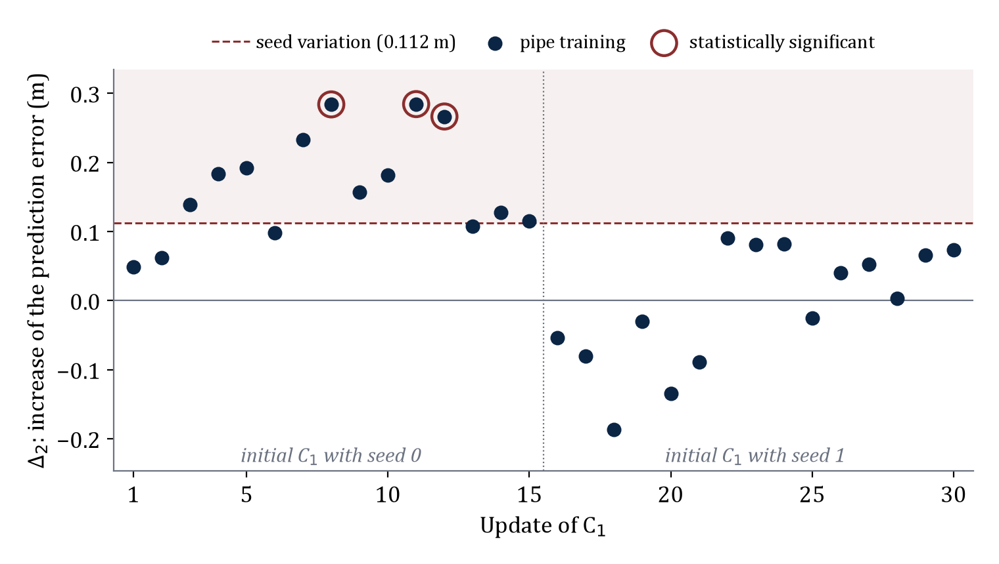
Results for RQ1: Prediction Model C₂
IV · RESULTS · RQ1
We test whether the prediction error increases after an update of C₁.
C₁′ is better in all 30 updates
δ₁ = +0.048 to +0.118 in mAP50
UPDATES WITH Δ₂ > 0 (OF 30), PIPE TRAINING
LEVEL | PIPE
1. Any increase | 23
2. Above seed variation | 11
3. Significant | 3
Randomness alone does not explain the 11 increases above seed variation.
All 11 increases above the dashed line come from the initial C₁ with seed 0 (left half).
RESULT FOR C₂
Entangled enhancement occurs in C₂. For the initial C₁ with seed 0, every update increases the prediction error, by +0.049 to +0.284 m.
An Empirical Analysis of Entangled Enhancement in an Autonomous Driving Pipeline
11

Slide 12
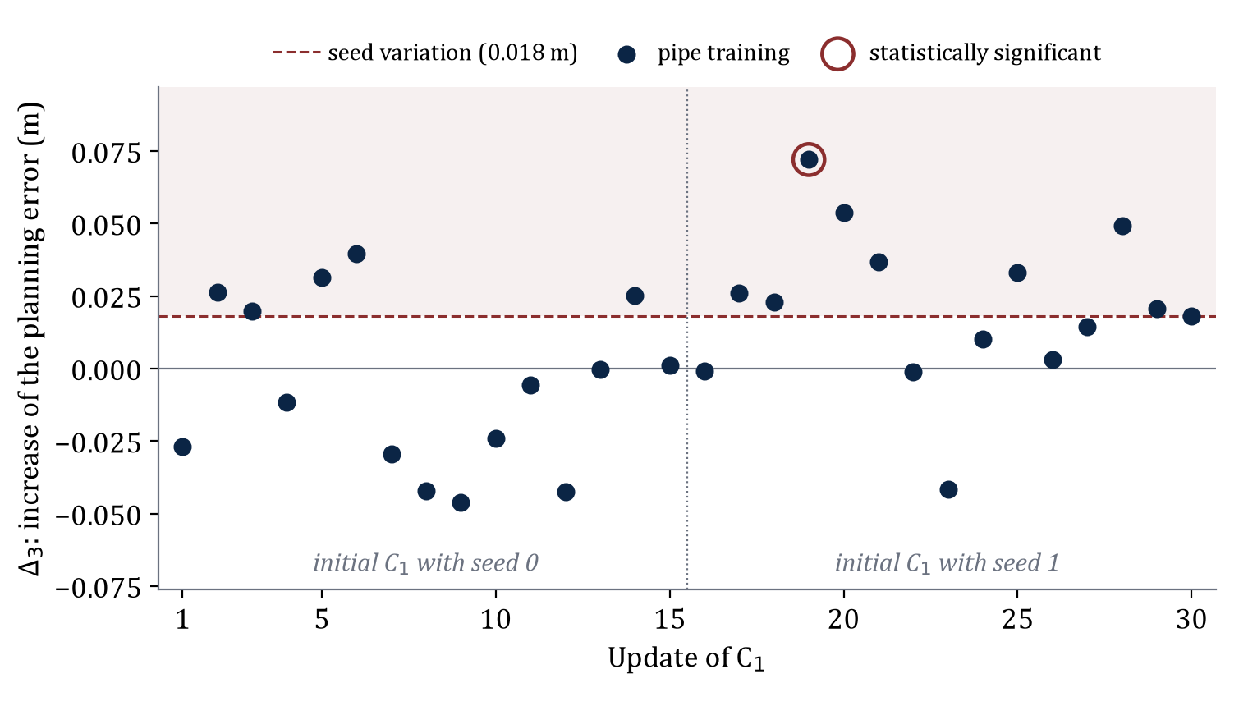
Results for RQ1: Planning Model C₃
IV · RESULTS · RQ1
We test whether the increase reaches the end of the pipeline, the planned path of C₃.
UPDATES WITH Δ₃ > 0 (OF 30), PIPE TRAINING
LEVEL | PIPE
1. Any increase | 18
2. Above seed variation | 13
3. Significant | 1
The increase is small
Largest Δ₃: 0.072 m, against a planning error of about 4 m.
The objects have a small effect on C₃
Removing all objects moves the plan of C₃ by only 0.73 to 1.65 m.
Only 1 increase of the planning error is statistically significant (circled).
ANSWER TO RQ1
An update that improves C₁ increases the prediction error in 23 of 30 updates, 11 beyond seed variation. The planning error increases in 18 updates, by at most 0.072 m.
An Empirical Analysis of Entangled Enhancement in an Autonomous Driving Pipeline
12

Slide 13
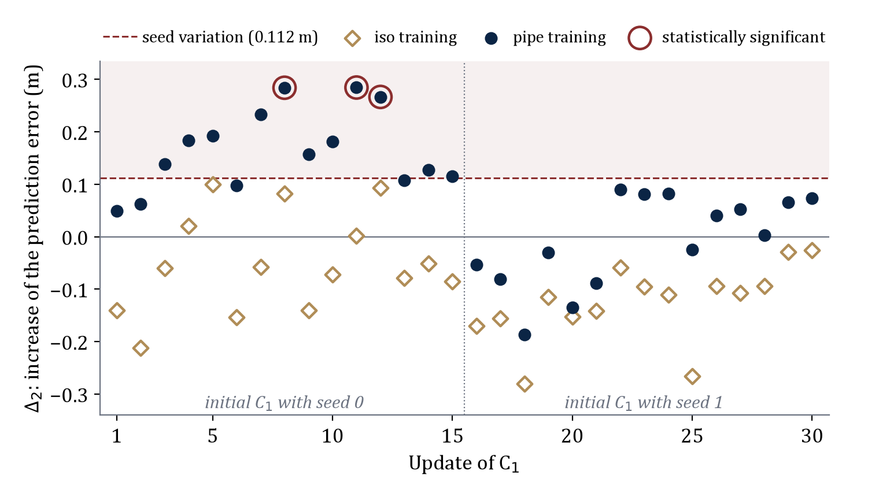
Results for RQ2: Pipe and Iso Training
IV · RESULTS · RQ2
We compare Δ₂ after pipe training and after iso training on the same 30 updates.
For C₃, the pattern is reversed
Δ₃ > 0 in 29 of 30 updates after iso training, 18 after pipe
UPDATES WITH Δ₂ > 0 (OF 30)
LEVEL | PIPE | ISO
1. Any increase | 23 | 5
2. Above seed variation | 11 | 0
3. Significant | 3 | 0
Δ₂ is larger after pipe training than after iso training in 30 of 30 updates.
Navy dots (pipe training) lie above gold diamonds (iso training) in every update.
RESULT FOR C₂
The increases above seed variation appear only after pipe training. The increase comes from the adaptation of C₂ to the errors of C₁.
An Empirical Analysis of Entangled Enhancement in an Autonomous Driving Pipeline
13

Slide 14
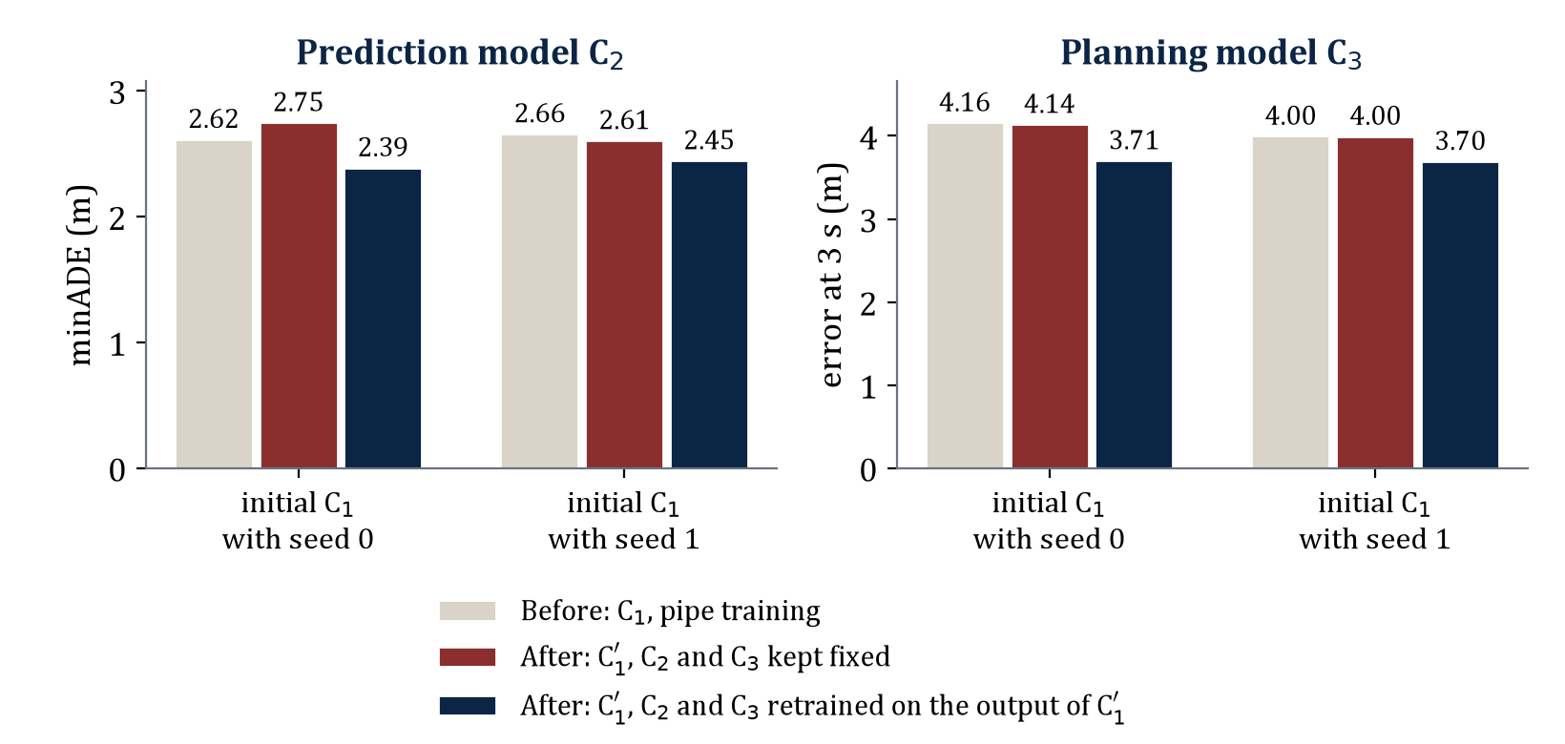
Results for RQ2: Retraining on the Output of C₁′
IV · RESULTS · RQ2
WHAT WE DO
We retrain C₂ and C₃ on the output of C₁′. We test one update of each initial C₁.
CHANGE IN ERROR
Prediction error: −0.36 m and −0.16 m
Planning error: −0.44 m and −0.30 m
RESULT
Both errors fall below their values before the update of C₁.
In every group, the navy bar (C₂ and C₃ retrained on the output of C₁′) is the lowest.
ANSWER TO RQ2
Yes, for C₂. The increase appears only after pipe training. Retraining on the output of C₁′ removes the increase. Adaptation does not explain the small increase of C₃.
An Empirical Analysis of Entangled Enhancement in an Autonomous Driving Pipeline
14

Slide 15
Conclusion
V · CONCLUSION
In this study, we investigated entangled enhancement in a real autonomous driving pipeline of three ML models. We updated the perception model C₁ 30 times. To find the cause, we compared two training modes of C₂ and C₃.
RQ1 · OCCURRENCE
An update that improves C₁ increases the prediction error of C₂ in 23 of 30 updates, 11 above seed variation. The planning error of C₃ increases by at most 0.072 m.
ENTANGLED
ENHANCEMENT IN C₂
RQ2 · CAUSE
The increase in C₂ comes from the adaptation of C₂ to the errors of C₁. The increase appears only after pipe training. Retraining C₂ and C₃ on the output of C₁′ lowers both errors.
CAUSE:
ADAPTATION
An Empirical Analysis of Entangled Enhancement in an Autonomous Driving Pipeline
15

Slide 16
Future Work
V · CONCLUSION
NEXT STEP
Early detection of entangled enhancement
We are developing a method that detects entangled enhancement before C₁′ is deployed, and before ground truth for the new data exists.
1
More test scenes
2
More initial C₁
3
Input to retraining models
With 50 test scenes, only 3 of 30 increases are statistically significant. More scenes give narrower intervals.
All 11 increases above seed variation come from one initial C₁. More initial C₁ show how often this case occurs.
The measured frequency of entangled enhancement can serve as the probability in the models of Wang and Machida.
An Empirical Analysis of Entangled Enhancement in an Autonomous Driving Pipeline
16

Slide 17
References
V · CONCLUSION
[1] Z. Wang and F. Machida, "Maintaining performance of a machine learning system against imperfect retraining," in Proc. IEEE COMPSAC, 2024, pp. 1782–1787.
[2] Z. Wang and F. Machida, "Exploiting the availability-continuity trade-off in imperfect retraining of machine learning systems," in Proc. IEEE ISSRE, 2025, pp. 406–417.
[3] D. Sculley et al., "Hidden technical debt in machine learning systems," in Proc. NIPS, 2015, pp. 2503–2511.
[4] R. Wu, C. Guo, A. Hannun, and L. van der Maaten, "Fixes that fail: Self-defeating improvements in machine-learning systems," in Proc. NeurIPS, 2021, pp. 11745–11756.
[5] Y. Xu et al., "Towards motion forecasting with real-world perception inputs: Are end-to-end approaches competitive?," in Proc. IEEE ICRA, 2024, pp. 18428–18435.
[6] H. Caesar et al., "nuScenes: A multimodal dataset for autonomous driving," in Proc. IEEE/CVF CVPR, 2020.
[7] G. Jocher and J. Qiu, "Ultralytics YOLO11," https://github.com/ultralytics/ultralytics, 2024.
[8] R. Girgis et al., "Latent variable sequential set transformers for joint multi-agent motion prediction," in Proc. ICLR, 2022.
[9] K. Renz et al., "PlanT: Explainable planning transformers via object-level representations," in Proc. CoRL, 2022.
[10] J.-T. Zhai et al., "Rethinking the open-loop evaluation of end-to-end autonomous driving in nuScenes," arXiv:2305.10430, 2023.
[11] Z. Li et al., "Is ego status all you need for open-loop end-to-end autonomous driving?," in Proc. IEEE/CVF CVPR, 2024.
An Empirical Analysis of Entangled Enhancement in an Autonomous Driving Pipeline
17

Slide 18
Thank You
Questions and comments are welcome.
Rashedul Arefin Ifty · Dependable AI Systems Laboratory · University of Tsukuba

Slide 19
Appendix A: Updates of Initial C₁, Seed 0
APPENDIX
# | DATA | EPOCHS | SEED | δ₁ | Δ₂ PIPE | Δ₂ ISO | Δ₃ PIPE | Δ₃ ISO
1 | 100 % | 10 | 1 | +0.077 | +0.049 | −0.141 | −0.027 | +0.035
2 | 100 % | 10 | 2 | +0.096 | +0.062 | −0.212 | +0.026 | +0.067 *
3 | 100 % | 10 | 3 | +0.072 | +0.139 | −0.060 | +0.020 | +0.078 *
4 | 50 % | 10 | 1 | +0.073 | +0.184 | +0.021 | −0.012 | +0.081 *
5 | 50 % | 10 | 2 | +0.077 | +0.192 | +0.100 | +0.031 | +0.063 *
6 | 50 % | 10 | 3 | +0.065 | +0.098 | −0.154 | +0.040 | +0.127 *
7 | 25 % | 10 | 1 | +0.064 | +0.233 | −0.058 | −0.030 | +0.020
8 | 25 % | 10 | 2 | +0.059 | +0.284 * | +0.082 | −0.042 | +0.071
9 | 25 % | 10 | 3 | +0.067 | +0.157 | −0.141 | −0.046 | +0.034
10 | 100 % | 5 | 1 | +0.094 | +0.182 | −0.073 | −0.024 | +0.052
11 | 100 % | 5 | 2 | +0.101 | +0.284 * | +0.001 | −0.006 | +0.040
12 | 100 % | 5 | 3 | +0.109 | +0.266 * | +0.093 | −0.042 | +0.033
13 | 100 % | 20 | 1 | +0.069 | +0.107 | −0.079 | 0.000 | +0.051
14 | 100 % | 20 | 2 | +0.080 | +0.127 | −0.051 | +0.025 | +0.059
15 | 100 % | 20 | 3 | +0.103 | +0.115 | −0.085 | +0.001 | +0.056
Changes in meters after the update. Shaded: larger than seed variation (0.112 m for Δ₂, 0.018 m for Δ₃). * Statistically significant. Data: share of Singapore 1 used for the update.
An Empirical Analysis of Entangled Enhancement in an Autonomous Driving Pipeline
19

Slide 20
Appendix B: Updates of Initial C₁, Seed 1
APPENDIX
# | DATA | EPOCHS | SEED | δ₁ | Δ₂ PIPE | Δ₂ ISO | Δ₃ PIPE | Δ₃ ISO
16 | 100 % | 10 | 1 | +0.068 | −0.054 | −0.170 | −0.001 | +0.021
17 | 100 % | 10 | 2 | +0.066 | −0.081 | −0.156 | +0.026 | +0.073 *
18 | 100 % | 10 | 3 | +0.065 | −0.187 | −0.280 | +0.023 | +0.026
19 | 50 % | 10 | 1 | +0.065 | −0.030 | −0.115 | +0.072 * | +0.084 *
20 | 50 % | 10 | 2 | +0.067 | −0.135 | −0.152 | +0.054 | +0.088 *
21 | 50 % | 10 | 3 | +0.079 | −0.089 | −0.141 | +0.037 | +0.070
22 | 25 % | 10 | 1 | +0.048 | +0.090 | −0.059 | −0.001 | +0.029
23 | 25 % | 10 | 2 | +0.078 | +0.081 | −0.095 | −0.042 | −0.004
24 | 25 % | 10 | 3 | +0.063 | +0.082 | −0.111 | +0.010 | +0.022
25 | 100 % | 5 | 1 | +0.086 | −0.025 | −0.267 | +0.033 | +0.068 *
26 | 100 % | 5 | 2 | +0.118 | +0.040 | −0.094 | +0.003 | +0.064 *
27 | 100 % | 5 | 3 | +0.115 | +0.052 | −0.107 | +0.015 | +0.050
28 | 100 % | 20 | 1 | +0.102 | +0.003 | −0.094 | +0.049 | +0.047
29 | 100 % | 20 | 2 | +0.071 | +0.065 | −0.029 | +0.021 | +0.022
30 | 100 % | 20 | 3 | +0.071 | +0.073 | −0.025 | +0.018 | +0.049
Changes in meters after the update. Shaded: larger than seed variation (0.112 m for Δ₂, 0.018 m for Δ₃). * Statistically significant. Data: share of Singapore 1 used for the update.
An Empirical Analysis of Entangled Enhancement in an Autonomous Driving Pipeline
20

Slide 21
Appendix C: Details of the ML Models
APPENDIX
C₁ · Perception model
C₂ · Prediction model
C₃ · Planning model
• YOLOv11n object detector
• Input: front-camera image, 640 pixels
• Trained 10 epochs on Boston 1, batch size 8
• Last checkpoint used; the test scenes never select a model
• mAP50 on the test scenes: 0.109 (seed 0), 0.117 (seed 1)
• AutoBot-Ego style transformer, centred on each target object
• Input: detections in the last four labelled images, relative to the target
• 2 encoder and 2 decoder layers, 128 features, 4 attention heads
• Output: six possible paths of 3 s
• Same object across images found by attention, without a separate matching step
• 736,799 parameters
• PlanT style transformer, one input token per object
• Object token: position, most likely path from C₂, class, confidence
• Further tokens: driving command and ego path of the last 1.5 s
• 4 layers, 128 features, 4 attention heads
• Recurrent decoder: six points of the planned path, 0.5 s apart
• 636,930 parameters
TRAINING OF
C₂ AND C₃
Boston 2: 86 training and 14 validation scenes. Early stopping on the validation scenes (patience 8 epochs for C₂, 10 for C₃). Mirror and rotation (±10°) augmentation. The error of C₂ uses the objects of C₁ matched one to one with a ground-truth object of the same class.
An Empirical Analysis of Entangled Enhancement in an Autonomous Driving Pipeline
21

